Slide 1
ASP.NET core Concepts
Concepts covered from 2 Dec 2024 to 9th Dec 2024

Slide 2
Middleware
Client(Browser) sends request to server, receives response
Middleware can make changes to request, perform some work on them before they reach server
Same for response

Slide 3
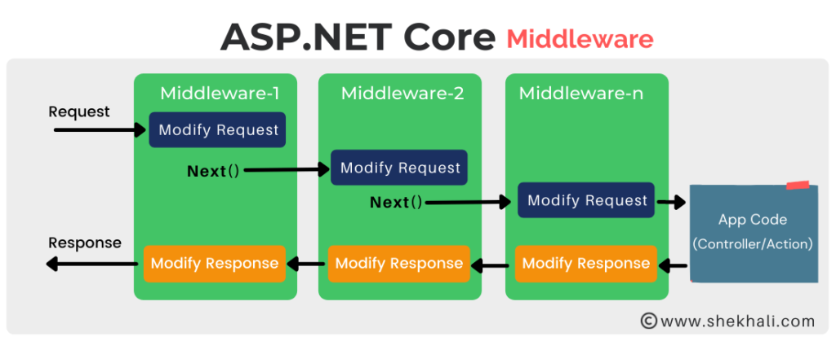

Slide 4
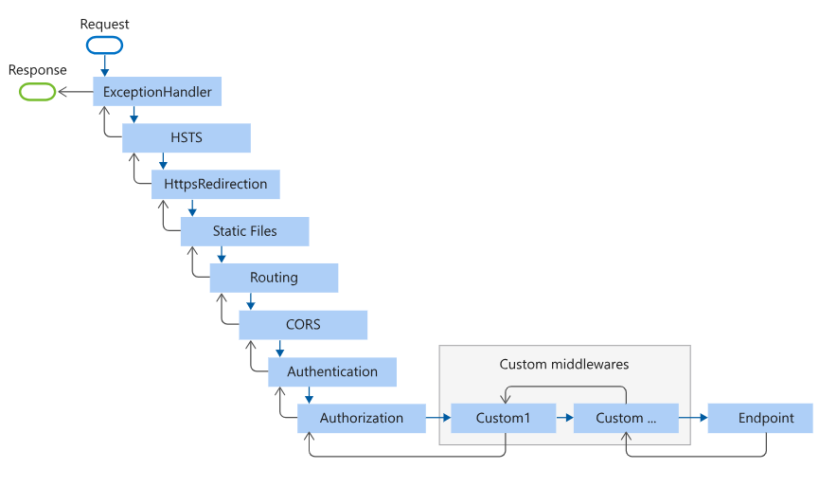

Slide 5
Demo: Middleware
Desktop->PMiddlewearegone

Slide 6
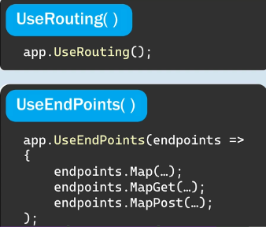
Routing
Endpoints: entrypoint~Url

Slide 7
Demo: Routing
C:\Users\ap34977\Desktop\12 Dec Asp.net core ppt\
Pendpointsegone

Slide 8
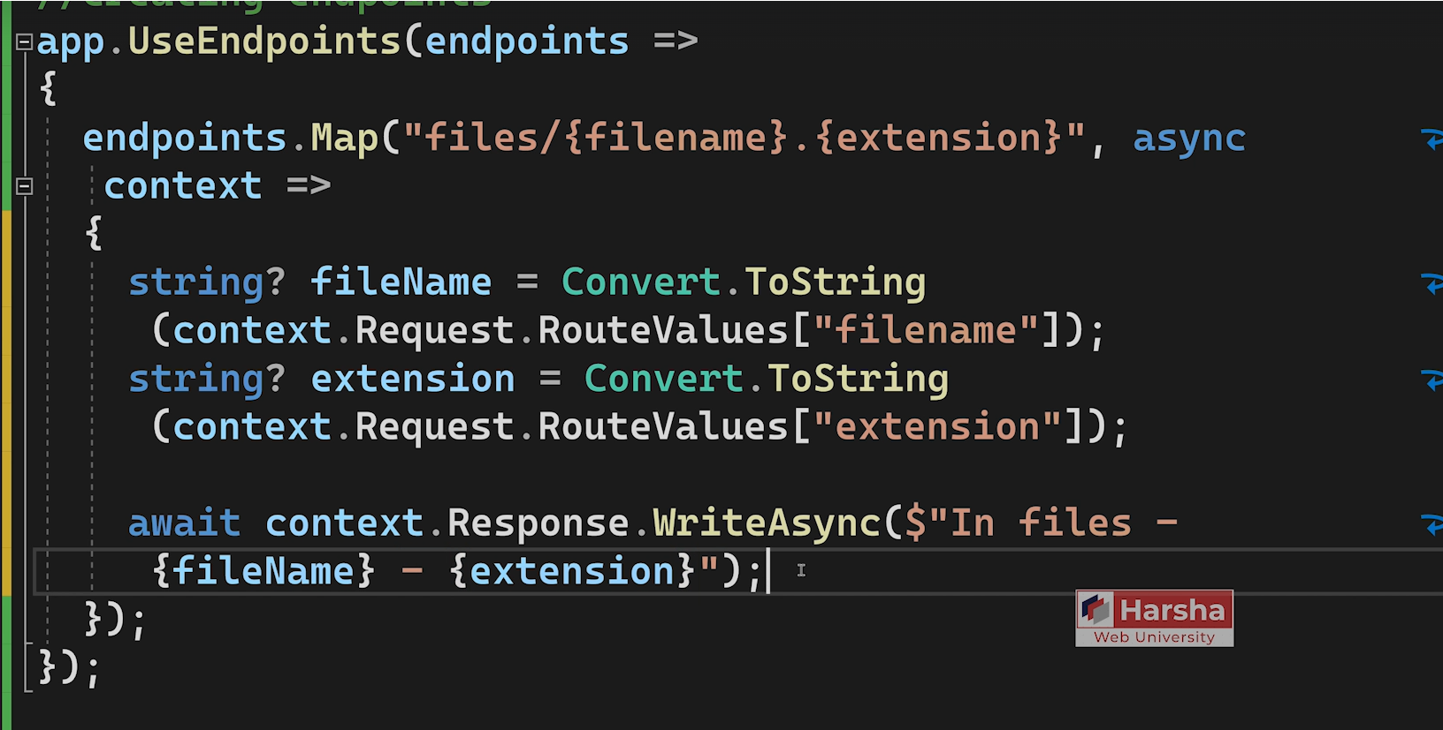
Route parameters using endpoints.Map

Slide 9
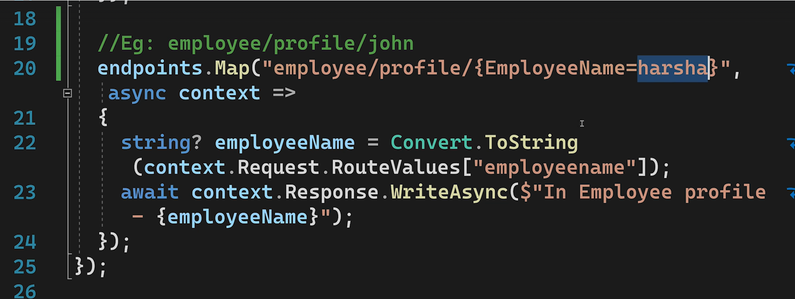
Default Route Parameters

Slide 10
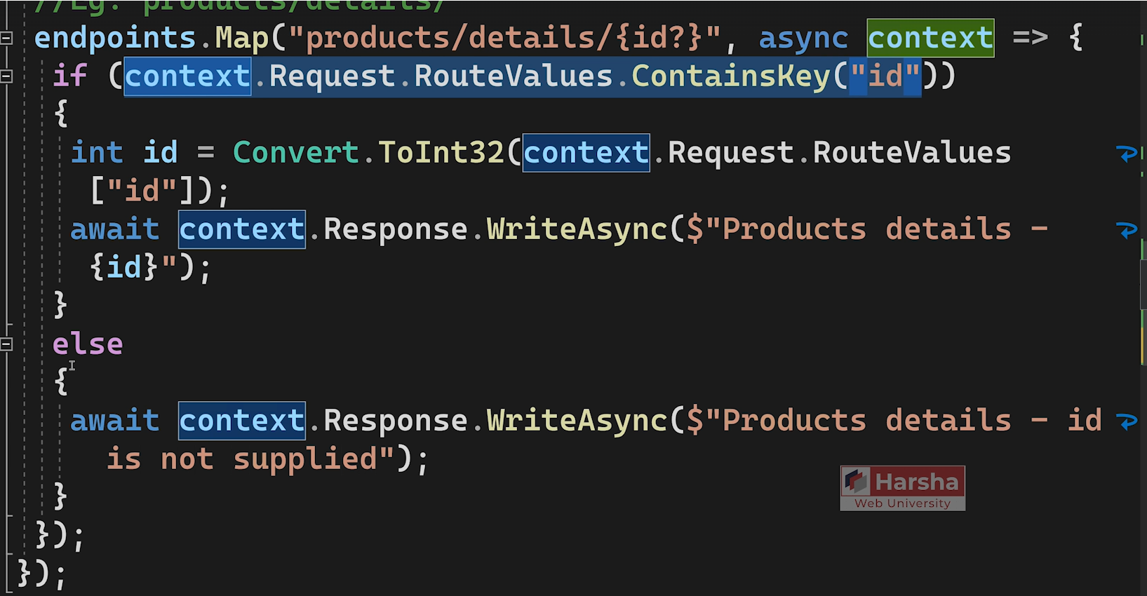
Optional Route Parameters and if statement

Slide 11
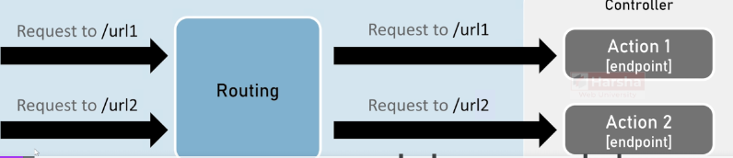
Routing using Controllers
Class that contains actions/methods

Slide 12
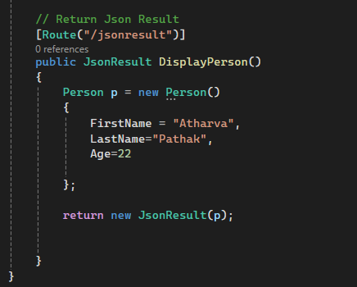
ContentResult
Type of response based on MIME type
Eg: text/plain , text/html, application/json

Slide 13
Demo : Routing & ContentResult
C:\Users\ap34977\Desktop\12 Dec Asp.net core ppt\
basiccontrollerone

Slide 14
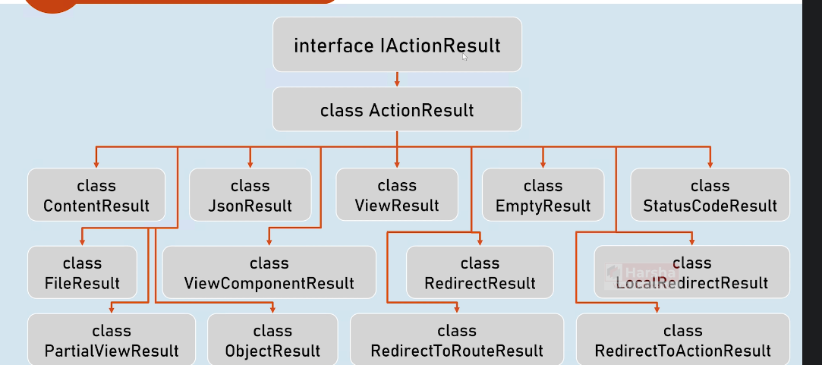
IActionResult
ParentInterface : By mentioning return type as IActionResult, you return subtypes of it

Slide 15
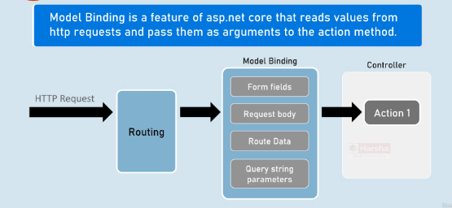
Model Binding

Slide 16
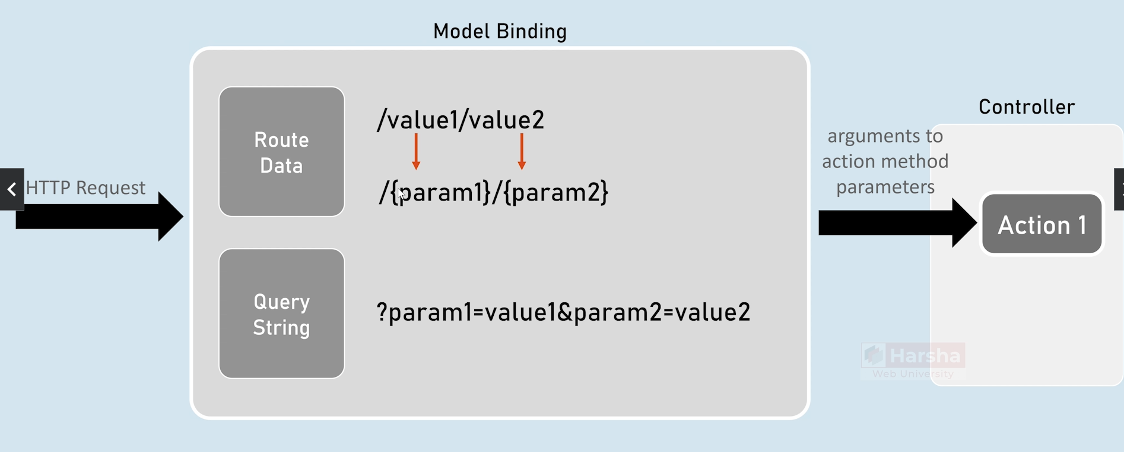
Model Binding: Route Data and Query String

Slide 17
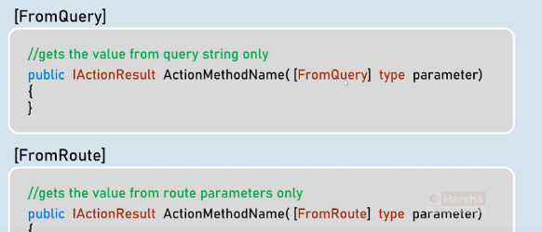
Route Data and Query String cont.

Slide 18
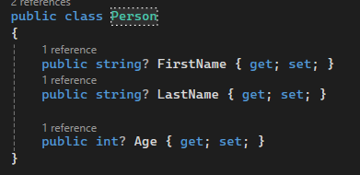
Models
A class that represents structure of data as properties

Slide 19
Demo: Model, Route Data & Query String
PModelRDQS

Slide 20
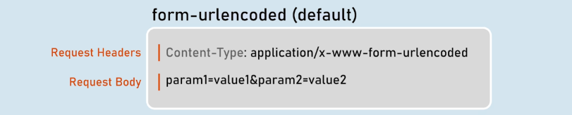
Model Binding: Form Fields
Generally used when you use submit button in html form.
Values of text box in html form=Form Fields

Slide 21
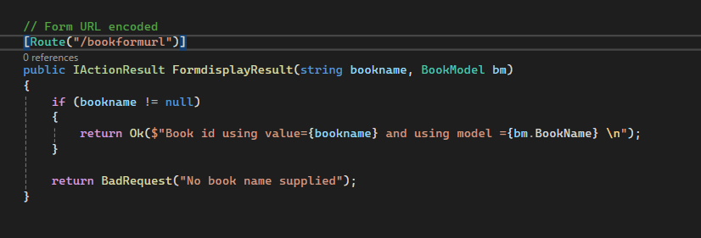

Slide 22
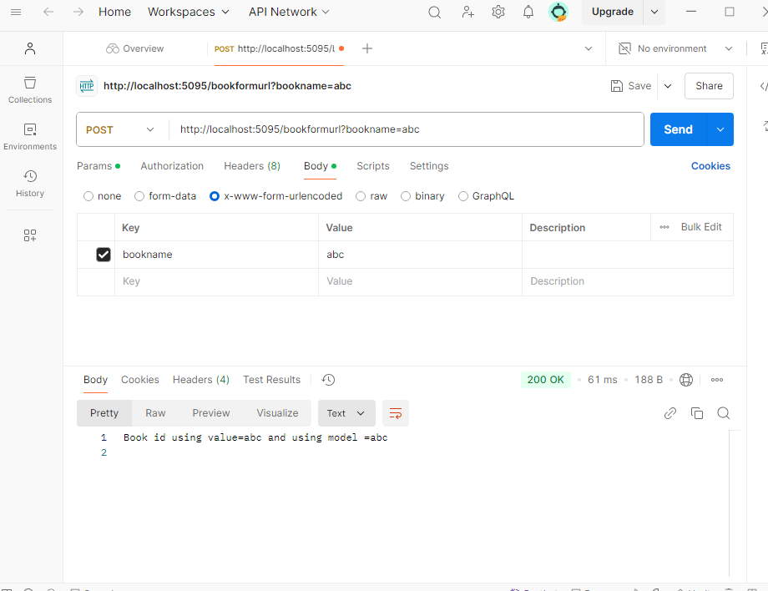

Slide 23
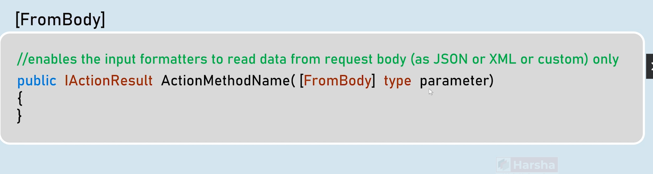
Model Bindings: Form Body

Slide 24
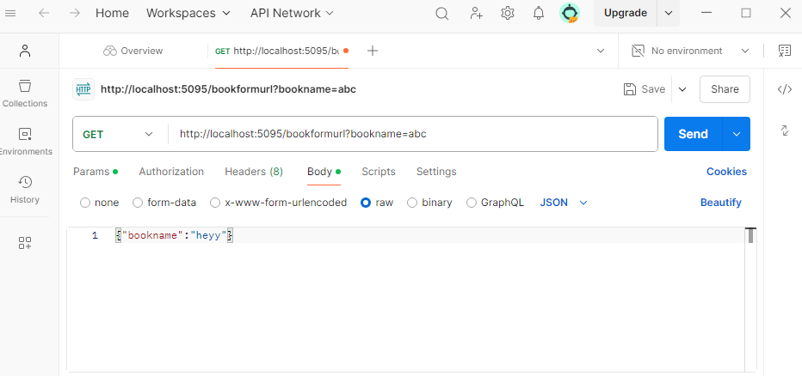

Slide 25
Demo: Form fields
PModelRDQS

Slide 26
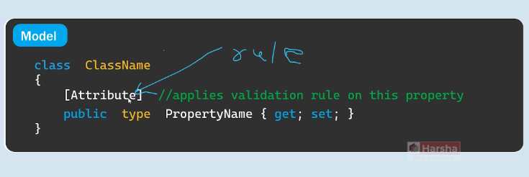
Model Validations

Slide 27
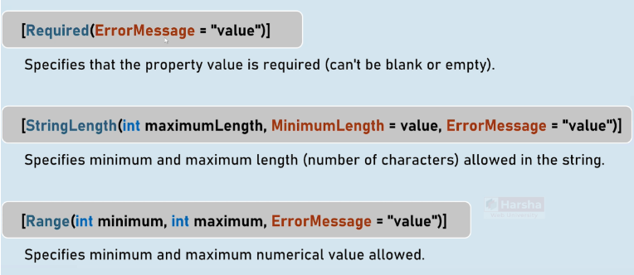

Slide 28
Demo: Model Validations
PModelRDQS

Slide 29
Model states
Weather data submitted by client successfully bounds to model properties
Informs weather data submitted follows validation rules or not
Eg : ModelState.IsValid: return true if there are no validation errors

Slide 30
Custom Model Binders
Inbuilt – frombody, fromroute,fromquery, form fields
Need of custom model binders: If we need to modify incoming data before mapping it to model
Eg: If first name and last name are supplied saperately, but we need to combine them and map them to model

Slide 31
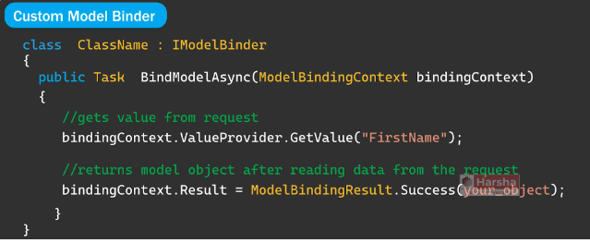

Slide 32
Demo : Custom model binders
PcustomModelbindeg

Slide 33
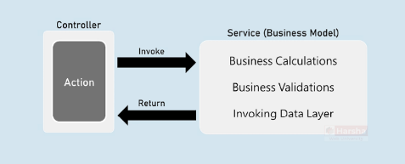
Services

Slide 34
Demo : Services
Pserviceg
Note : Add new class library for creating service, and add project reference using dependencies folder
Solution->add->new project-> Class Library

Slide 35
Thank you

